Slide 2
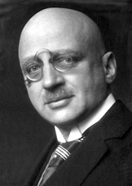
Fritz Haber

Slide 3
Zyklon A
Zyklon B

Slide 4
Chlorine Gas

Slide 6
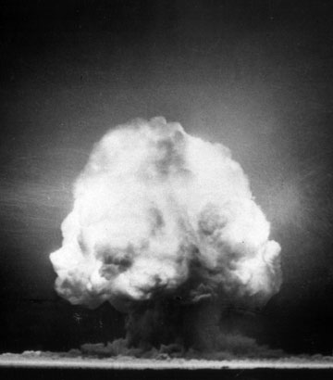

Slide 7
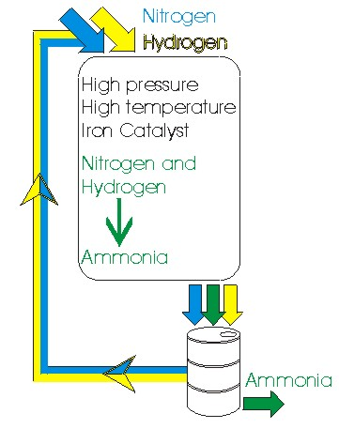
The Haber Process

Slide 8
1909 : ~1.5 Billion
2011 : ~6.9 Billion
2050 : ~12 Billion
(estimated)

Slide 9

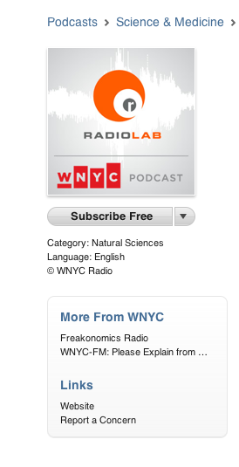

RadioLab.org
iTunes
Search: Fritz Haber
Search: RadioLab

Slide 10
“The Bad Show”

